Slide 1
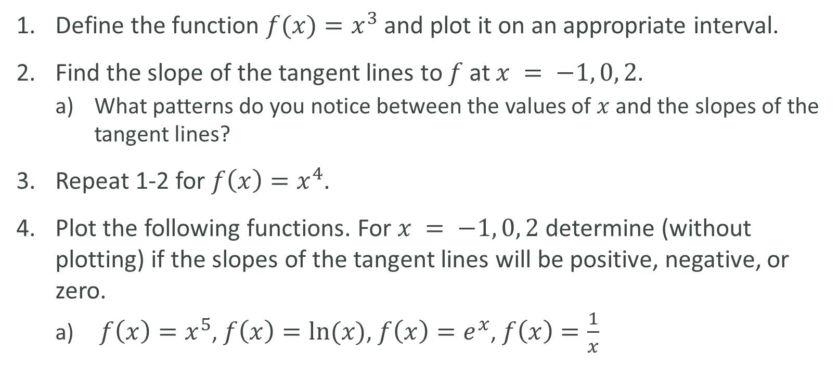
LAB
Define the function $f(x)=x^{3}$ and plot it on an appropriate interval.
Find the slope of the tangent lines to $f$ at $x = −1, 0, 2$.
What patterns do you notice between the values of $x$ and the slopes of the tangent lines?
Repeat 1-2 for $f\left(x\right)=x^{4}$.
Plot the following functions. For $x = −1, 0, 2$ determine (without plotting) if the slopes of the tangent lines will be positive, negative, or zero.
$f\left(x\right)=x^{5}$, $f\left(x\right)=ln⁡(x)$, $f\left(x\right)=e^{x}$, $f\left(x\right)=\frac{1}{x}$

